Slide 1
Working Together
To advance positive, cradle-to career-outcomes
for ALL young people
2020 Investor Briefing

Slide 2
Now What?
What?
FUTURE DIRECTION
ACCOMPLISHMENTS
So What?
OUTCOMES AND IMPACT

Slide 3
WHAT WE DO
All Kids. Our Future.
Achieve Brown County convenes, facilitates and supports the collaborative efforts of businesses, non-profits, schools, government agencies and individual community members to create a truly equitable Brown County in which ALL young people have what they need to succeed in school, work and life.
WHAT

Slide 4
01
Our Process
Shared Community Vision
Build and maintain a shared community vision and common framework for measurably improving outcomes from cradle to career.
WHAT

Slide 5
02
Our Process
Evidence-Based Decision Making
Collect, research and analyze community data to paint a complete picture of what’s going on with young people and inform and guide collective decision-making.
WHAT

Slide 6
03
Our Process
Collaborative Action
Align on and pursue sustainable, collaborative action that makes the biggest difference and affects systems change.
WHAT

Slide 7
Our Values
Results
Commitment to Equity
We seek and value all types of diversity, put equity into action daily and strive to dismantle inequities, including those present in ourselves, our organization and our community.
Community
Courage
Progress
WHAT

Slide 8
Making a Difference
Convened and facilitated a partnership between all three county health care systems and the Birth to 3 Program to develop and implement a standardized system of developmental screening and care
+
Convened and facilitated a partnership between four of the county’s eight school districts and multiple non-profits to develop and implement a standardized system of mentoring
+
Built and populated a Community Information System* for combining individual record-level data from entities across public, private and education sectors
Brown County is the only community in the country where these three things exist.
* Originally developed by the Brown County United Way and co-owned by Achieve Brown County
WHAT

Slide 9
=
Created the conditions for community-led collective impact that have led to significant improvements in five measured outcomes critical to the success of Brown County youth
Difference MADE
SO WHAT

Slide 10
BY THE NUMBERS
Collaborative Action Partners
16
Non-Profit Organizations
14
Educational Institutions
3
Health Care Systems
3
Government Agencies
1
Sovereign Nation
SO WHAT

Slide 11
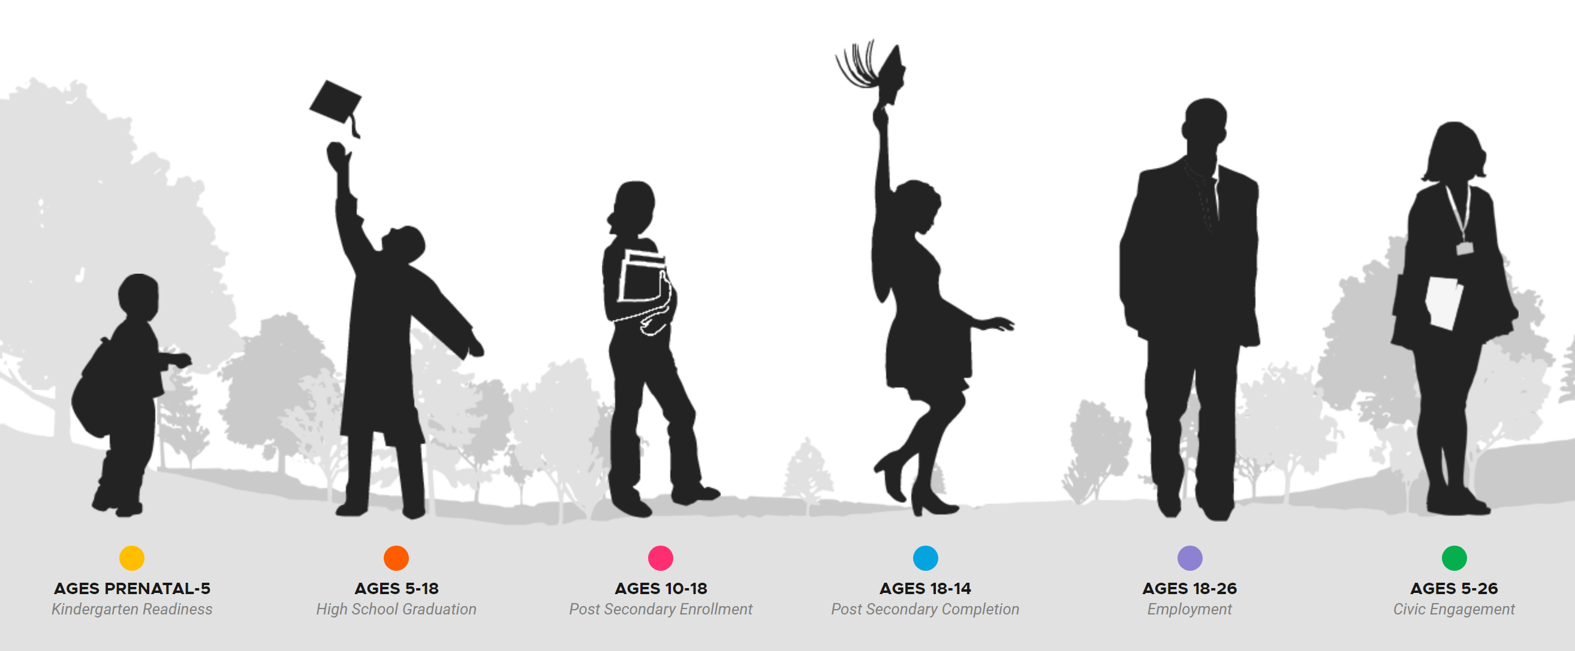
BY THE NUMBERS
Community Outcomes Dashboard
Sources: Local 5K schools, Wisconsin Department of Public Instruction, National Student Clearinghouse, Wisconsin Department of Workforce Development
GOAL
Every child is prepared for school
88%
of all kids meet literacy benchmark
+5%
since 2018
GOAL
Every child succeeds in school
93%
of all kids graduate from high school
+6%
since 2014
GOAL
Every youth is connected to & engaged in an accredited career pathway
61%
of all youth enroll or enter in post- secondary or military by fall after graduation
+1%
since 2014
GOAL
Every young adult attains post-secondary or career training
47%
of all youth attain degree or credential in 6 years
+11%
since 2016
GOAL
Every young adult is engaged in the workforce
46%
of all young adults earn >200% of the poverty level
+6%
since 2016
GOAL
Every child, youth and young adult contributes to the community
NOT MEASURED
AGES 18-24

Slide 12
ABC’s Impact:
Aligning on Developmental Screening
Colleen Peebles
Manager of Pediatrics
HSHS St. Vincent Children’s Hospital
and Prevea Pediatrics
SO WHAT

Slide 13
Partnering with Achieve Brown County
Early screening for all children
Standardized screening tool: Ages and Stages Questionnaire (ASQ)
Implementing ASQ clinic wide
Licensing ASQ into Epic, the electronic medical record
Birth to 3 – the importance of signatures
SO WHAT

Slide 14
Results
Formed the Community Online Screening (COAS) Team
Gathering data
Enhancing partnerships
Helping more children in Brown County
SO WHAT

Slide 15
ABC’s Impact:
Scaling a Transformational Program
Johanna Wicklund
Senior Director of Strategy and Measurement
Boys and Girls Club of Greater Green Bay
SO WHAT

Slide 16
GRADUATION TASK FORCE - ACTION TEAM 2.1
GOAL: EVERY STUDENT GRADUATES HIGH SCHOOL
Focus: Expand Mentoring Program Partnerships
SO WHAT

Slide 17
BE GREAT: GRADUATE
200
EXPANSION SUCCESS
Partnership Results:
Piloted new school-based model of BE GREAT: Graduate mentoring program (Alpha Test)
Developed a systematic process for replication & evaluation (Beta Test)
Scaled from supporting 20 students to being able to reach 200 students in the upcoming academic year (Gamma Test)
150
100
50
0
2018
2019
2020
SO WHAT

Slide 18
ABC’s Impact:
Strengthening a National Movement
Jennifer Blatz
President and CEO
StriveTogether
SO WHAT

Slide 19
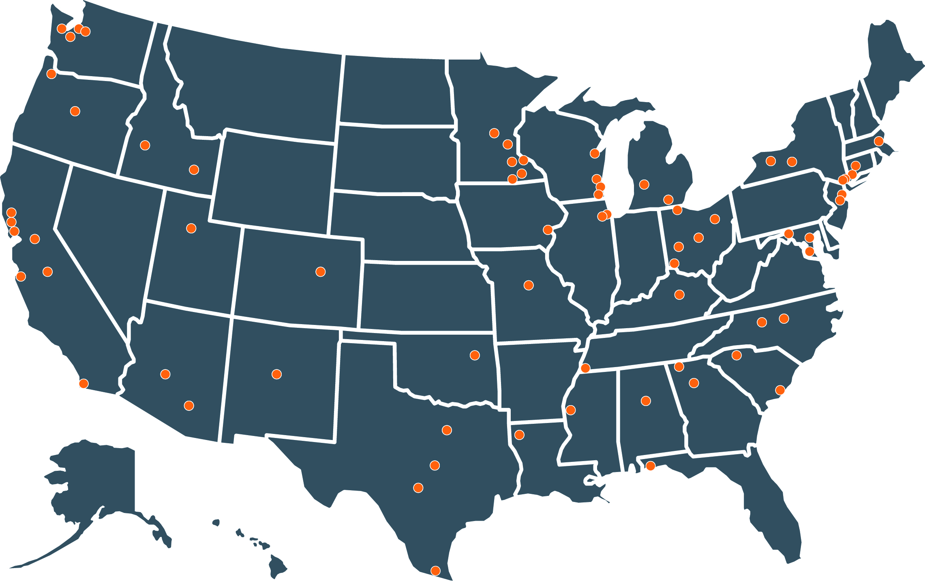
The StriveTogether Cradle to Career Network

Slide 20
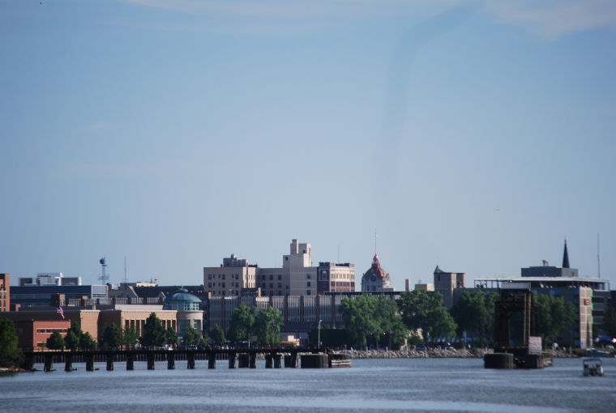
Achieve Brown County National Impacts
Groundbreaking work to integrate data systems
COVID-19 resource mapping tool
Partnering to drive state policy change
SO WHAT

Slide 21
Stepping Up in Uncertainty
COVID-19 Resource and Response Map and Collective Response Team
Collaborative Action Teams and CIS
Innovation consistent with core purpose
CONVENE
BREAKTHROUGH
BUILD UP
TA
DA
FACILITATE
SUPPORT
The Flywheel Effect
© Jim Collins
DPI / School District Data Sharing
Energized and engaged stakeholders
Digital Access
Team
NOW WHAT

Slide 22
ABC’s Impact:
Unleashing the Potential of Community Data
Tina Chang
Chairwoman and CEO
SysLogic Inc.
NOW WHAT

Slide 23
Current State
Data Sharing Partners
Community
Information
System
DATA IN
INTEGRATION / ANALYSIS
INFORMATION / COLLABORATIVE ACTION OUT
NOW WHAT

Slide 24
Potential State
INCREASED IMPACT, SUSTAINABILITY AND SROI
Community Member Experiences / Ideas
Other Community-Led Collective Impact
Integrated / Analyzed Data
Integrated / Analyzed Data
Data Consumption
Partners
NOW WHAT

Slide 25
ABC’s Impact:
Realizing a Full Return-on-Investment
Christopher Elfner
Vice President Accountable Care Strategy
Bellin Health
NOW WHAT

Slide 26
A VIEW OF OUR FUTURE
15-Year Roadmap
2025-29
COLLABORATIVE ACTION
Achieve and sustain positive outcomes and systems change
2020-24
EVIDENCE-BASED DECISION MAKING
Realize the full potential of community data
2014-19
SHARED COMMUNITY VISION
Create the conditions for community led collective impact
NOW WHAT

Slide 27
Thank You / Q&A

